Slide 1


Adverse events Understanding &
Reporting

Slide 2
Learning Objectives
Definition of pharmacovigilance
Definition of Adverse Event
Importance of Adverse Event Reporting
Responsibility of Synokem employees in AE Reporting
Where to report ?
What to report ?

Slide 3
What is Pharmacovigilance
Science and activities relating to the detection, collation, assessment, understanding and prevention of Adverse Event (AE) or any other drug related problem.

Slide 4
What is Adverse Event (AE)
An adverse event is any undesirable experience, associated with the use of a medicine/drug in a patient, which may or may not be associated with the drug.
Example…
Medication related side effects . Any symptoms/ sign (e.g. Vomiting, allergy etc.)
Abnormal laboratory findings ( abnormal blood test report)
Medication error ( inappropriate medication use)
Failure of therapy (lack of effect of drug)
Overdose (taking more than the recommended dose)
Misuse/ abuse ( taking more than recommended dose of certain cough syrups to get high)

Slide 5
What is Serious Adverse Event
Serious adverse event is any untoward medical occurrence which results in:
Death
Life-threatening condition
Hospitalization (initial or prolonged)
Disability (persistent or significant disability or incapacity)
Birth defect (congenital anomaly)
Other important medical events as decided by physician

Slide 6
What to report ?
Following key information to be collected/reported to Synokem PV Team:
Patient information: only patient’s initials (e.g. If patient’s name is Amit Prakash ; initials will be AP)
Name of suspected drug manufactured by Synokem/Nitin Lifesciences or Marketed by Kemsyn Lifesciences Pvt Ltd.
Adverse event description in brief as informed by patient
Name of reporter (if reporter is other than patient himself)

Slide 7
Where to report/communicate adverse event?
If you become aware of any adverse event associated with the use of medicines manufactured by Synokem/Nitin Lifesciences
Report such event to the Synokem’s Pharmacovigilance department
Akash Pandey (Pharmacovigilance Officer In charge)
Email: pv@synokempharma.com
pv@kemsynlifesciences.com
Helpline No. +918929055915

Slide 8
Why reporting of Adverse event is important ?
All adverse events are analyzed to determine the cause i.e. whether the adverse event has happened due to the inherent nature of the drug or it is unrelated to drug or there is a product quality related issue.
Once causality is established, new adverse events/adverse drug reaction are included in product label or prescribing leaflet for information of physicians/patients to ensure patient safety
Therefore, it is our responsibility to report all adverse events/adverse drug reaction, (which we become aware of) associated with use of drug products

Slide 9
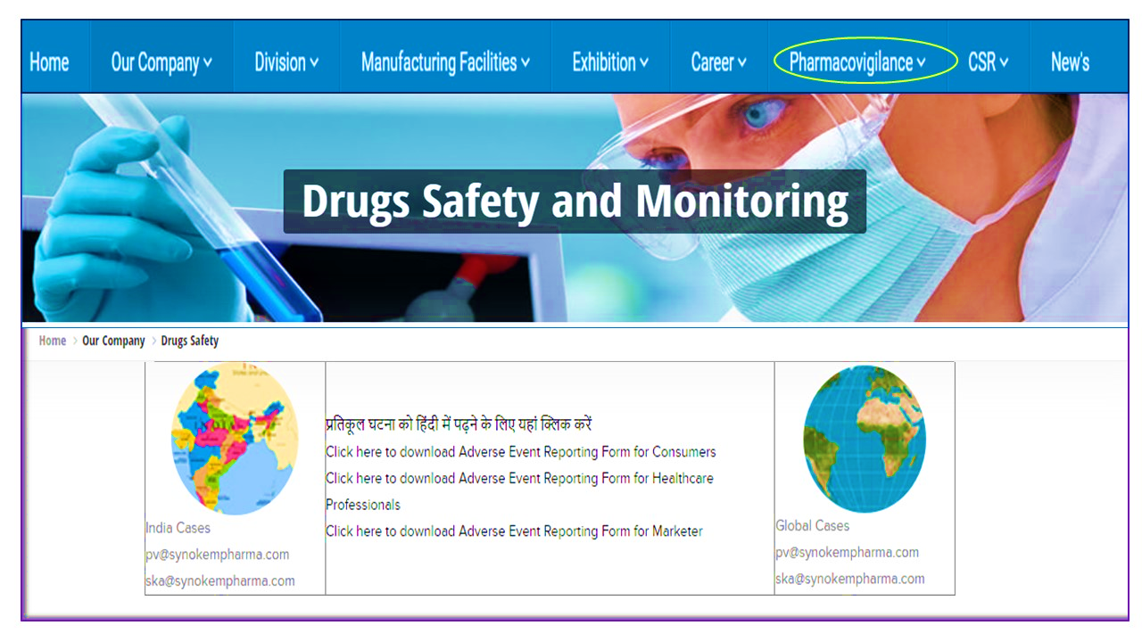
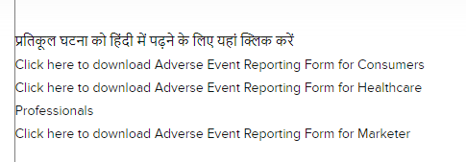
“Pharmacovigilance” Tab on Company Website

Slide 10



